Slide 1



Slide 2


I.O. vs. Affiliate
What’s the Difference?
DAVID DIDOMENICO of Showtime Transportation of Tampa
JAY ERLICH of Europe Limousine
JASON JANOWITZ of Larry’s Private Car and Limousine
Moderator: DOUG SCHWARTZ of Executive Ground Transportation
Audio Visual
Sponsor
Coffee Sponsor

Slide 3


Welcome & Thank You to Our Sponsors
Coffee Sponsor
Audio Visual Sponsor

Slide 4
DEFINITIONS
Affiliate
Independent Operator aka I.O. (or I/O)
Audio Visual
Sponsor

Slide 5
USING WHICH ONE?
Why
Sourcing
Advantages
Disadvantages
Audio Visual
Sponsor

Slide 6
THE PROCESS
Onboarding
Quality Control/Failures
The Legal Stuff
Dispatch Technique
Insurance
Audio Visual
Sponsor

Slide 7
TECHNOLOGY
Software
Driver Apps
Cameras/Metrics
GPS
Audio Visual
Sponsor

Slide 8
RECONCILIATION
The Trip Is Over, Now What?
Payment Terms
Audio Visual
Sponsor

Slide 9
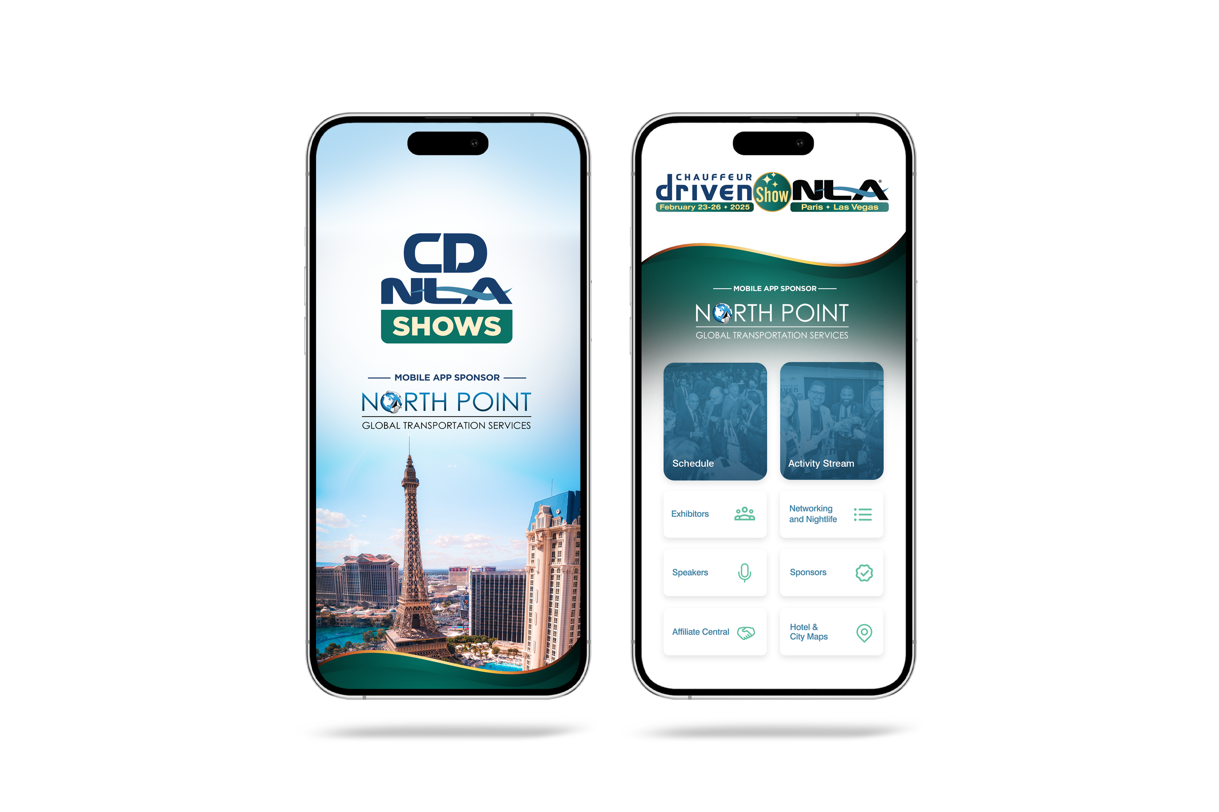


Let Us Know How
We Did!
Fill Out the Survey

Slide 10
Thank You for Joining Us!

